Slide 1
Vulnerabilities of McEliece in the World of Escher
Ray Perlner, Dustin Moody
National Institute of Standards and Technology
Gaithersburg, Maryland, USA
Ray.Perlner@NIST.gov; Dustin.Moody@NIST.gov

Slide 2
Outline
“McEliece in the World of Escher” [Gligoroski, Samardjiska, Jacobsen, Bezzateev 2014]
A McEliece variant promising encryption and signatures
New ideas:
Error sets
List decoding
Encryption and signature schemes:
Private key
Decoding algorithm
Major Results
ISD for the error vector (signature forgery)
ISD for the private key (key recovery for both encryption and signature)
Countermeasures?

Slide 3
Commonalities with other McEliece Variants.
Private key operation is a decoding problem
Generator Matrix form:
$mG_{pub}+e=c sG_{pub}+e=H(m)$
Parity Check Matrix form:
$H_{pub}{(c−e)}^{T}=0 H_{pub}{(H(m)−e)}^{T}=0$
Public Generator/Parity Check matrix is disguised Private Generator/Parity Check matrix
$$G_{pub}=SGP H_{pub}=S^{′}HP$$

Slide 4
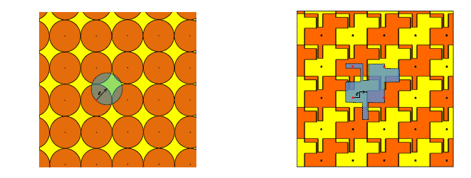
Escher McEliece Error Sets
Standard Code-based crypto
Error vector is a biased sample from the 1-bit alphabet (0,1)
E.g. (00|10|11|00|00|10|00|01)
Mean: 0.33
44% 00; 22% 01; 22% 10; 11% 11
Error sets
Error set is an unbiased sample from a limited l-bit alphabet. E.g. (00,01,10)
E.g. (01|00|00|01|00|10|01|01)
Mean: 0.33
33% 00; 33% 01; 33% 10; 0% 11

Slide 5
Error Set Density, $ρ$
For an error set of block size l bits, Gligoroski et al define the density as:
$$ρ_{ℓ}=D\left(ℓ\right)={|E_{ℓ}|}^{1/ℓ}$$
For example for the error set (00,01,10)
$$ρ_{ℓ}=3^{1/2}$$

Slide 6
Escher McEliece The Private key

Slide 7
Escher McEliece Decoding Encryption
Divide Message as $x_{1}\left|x_{2}\right|…|x_{w}$, where $x_{i}$ has length $k_{i}$
Divide Ciphertext as $y_{0}\left|y_{1}\right|y_{2}|…|y_{w}$, where $y_{0}$ has length $k$ and the other $y_{i}$ have length $n_{i}$
Divide $y_{0}$ as $y_{0}[1]\left|y_{0}\left[2\right]\right|…|y_{0}[w]$, where $y_{0}[i]$ has length $k_{i}$
Step $0$: Compile a list of all the possible decodings of the first $k_{1}$ bits of $y$
$$x_{1}=y_{0}\left[1\right]+e_{0}[1]$$
Step $1≤i≤w$: Update by checking consistency and (if necessary) extending the decoding.
$${(x}_{1}|…|x_{i})⋅B_{i}+y_{i}=e_{i}$$
$$x_{i+1}=y_{0}\left[i+1\right]+e_{0}[i+1]$$
Note the complexity of decoding is set by the list size at step 1: $ρ^{k_{1}}$, so $k_{1}$ can’t be too big.

Slide 8
Escher McEliece Decoding Signatures
Divide Message as $x_{1}\left|x_{2}\right|…|x_{w}$, where $x_{i}$ has length $k_{i}$
Divide Ciphertext as $y_{0}\left|y_{1}\right|y_{2}|…|y_{w}$, where $y_{0}$ has length $k$ and the other $y_{i}$ have length $n_{i}$
Divide $y_{0}$ as $y_{0}[1]\left|y_{0}\left[2\right]\right|…|y_{0}[w]$, where $y_{0}[i]$ has length $k_{i}$
Step $0$: Compile a list of some of the possible decodings of the first $k_{1}$ bits of $y$
$$x_{1}=y_{0}\left[1\right]+e_{0}[1]$$
Step $1≤i≤w$: Update by checking consistency and (if necessary) extending the decoding.
$${(x}_{1}|…|x_{i})⋅B_{i}+y_{i}=e_{i}$$
$$x_{i+1}=y_{0}\left[i+1\right]+e_{0}[i+1]$$
Note the complexity of decoding is set by the list size at step w. Needs to be at least ${\left(\frac{2}{ρ}\right)}^{n_{w}}$to survive consistency checks. Thus $n_{w}$ can’t be too big.

Slide 9
On to attacks!

Slide 10
Information set Decoding for Errors
Permute the columns of $G_{pub}$
$${G′}_{pub}=G_{pub}P′=\left(A | B\right)$$
Check that A is invertible
Guess the first $k$ bits, $v$, of the permuted error vector $eP$. If so:
$$yP′=m\left(A | B\right)+eP′=\left(c|d\right)=\left(mA+v | D\right)$$
$$\left(c−v\right)A^{−1}=m$$
Check the guess by computing the weight/pattern of:
$$y−\left(c−v\right)A^{−1}G_{pub}$$
If the guess fails, repeat.

Slide 11
Using ISD for Errors to Forge Signatures
The efficiency of ISD depends on the probability of guessing $k$ bits of the error vector of a valid signature
Note that there is not a unique valid signature for each message.
For the error set (00, 01, 10)
We can guess a single bit (0), and the other bit is guaranteed to be valid.
By choosing the permutation such that all $k$ information-set bits come from different blocks, we guarantee that $2k$ of the $n$ bits form a valid error vector.
The probability the remaining $n−2k$ bits are also in the error set is:
$${p=\left(\frac{\sqrt{3}}{2}\right)}^{n−2k}.$$
Examples:
Code (650,306): Claimed security $2^{87.54}$; $p=2^{−7.88}$
Code (1578,786): Claimed security $2^{137.11}$; $p=2^{−1.25}$

Slide 12
Can this forgery be avoided?
This attack can be avoided by
Only accepting signature error vectors with hamming weight $\sim n/3$.
This only gets${ p=\left(\frac{\sqrt{3}}{2}\right)}^{n−1.5k}$ … not enough.
Increasing the ratio $\frac{n}{k}$
But this will enable/worsen other attacks. More later …

Slide 13
Information Set Decoding for the Private Key.
Information set decoding algorithms find low weight vectors in the row space of a matrix
Can be applied to $G_{pub}$ or $H_{pub}$.
Note that $G_{pub}$ and $H_{pub}$ have the same row spaces as $G$ and $H$ up to a Permutation.
$$wt.\left(vG\right)=wt.\left(vGP\right)=wt\left(vS^{−1}SGP\right)=wt(\left(vS^{−1}\right)G_{pub})$$
$$wt.\left(vH\right)=wt.\left(vHP\right)=wt\left(v{S′}^{−1}S′HP\right)=wt(\left(v{S′}^{−1}\right)H_{pub})$$

Slide 14
Where are the low-weight targets?
This has to be small for signature
This has to be small for encryption

Slide 15
Once we have low weight vectors, then what?
The nonzero bits of low weight vectors all come from the same columns in the private matrix
Encryption
$H$: Columns 0, …, $k_{1}−1;$ $k,$ …, $k+ n_{1}$
Signature
$G$: Columns 0, …, $k_{1}−1;$ $n−n_{w}, …, n−1$
The nonzero bits of the low weight vectors will therefore come from the images of these columns under $P$
So, we can simply find these columns and lop them off.
The result is a smaller matrix of the same form we started with.
Repeating the process is generally easier.

Slide 16
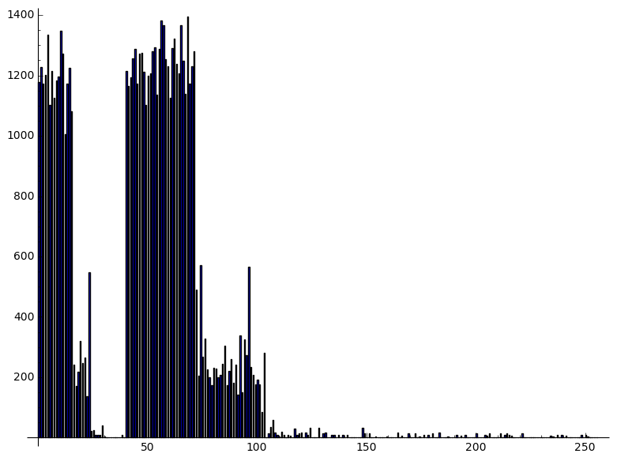
Detecting the Structure through Statistics.
$$H=$$
$$I_{n−k}$$

Slide 17
Removing The Columns

Slide 18
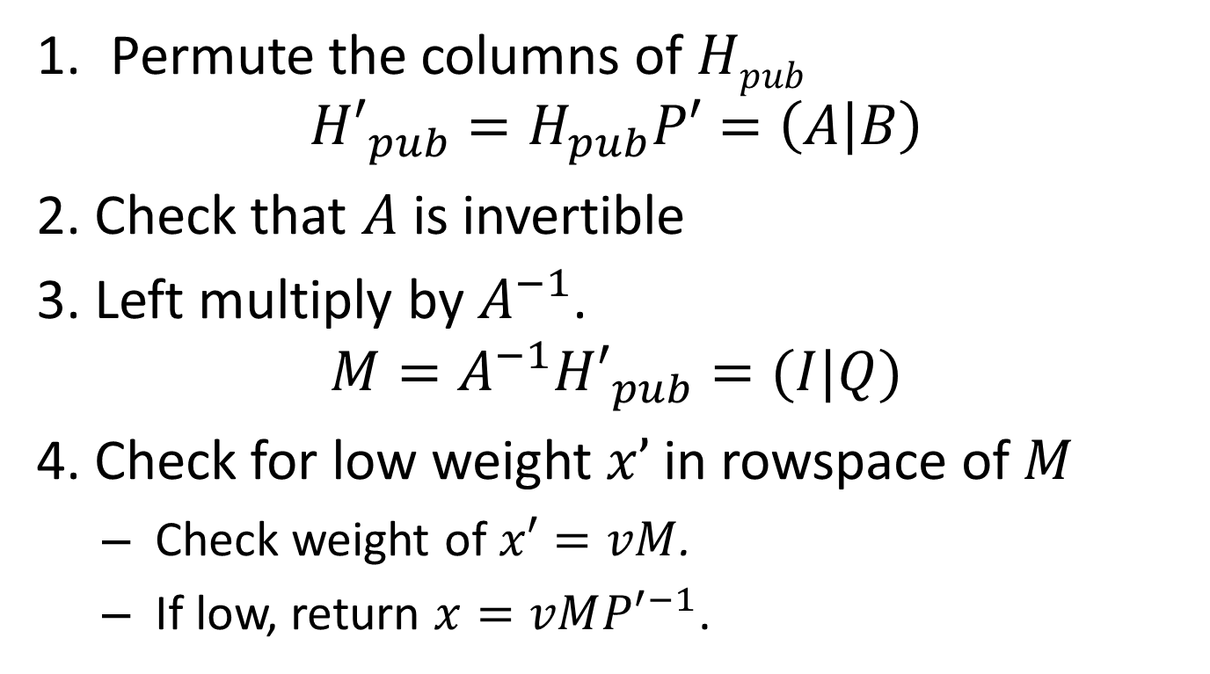
Generic information set decoding
Permute the columns of $Hpub$
$${H′}_{pub}=H_{pub}P′=\left(A | B\right)$$
2. Check that $A$ is invertible
3. Left multiply by $A^{−1}$.
$$M=A^{−1}{H′}_{pub}=(I|Q)$$
4. Check for low weight $x’$in rowspace of $M$
Check weight of $x′=vM$.
If low, return $x=vM{P′}^{−1}$.

Slide 19
Why does this work?
H’= HPP’, H’_{pub}, M all have the same rowspace
vM is the unique element of that rowspace with prefix v
v is a guess for the first n-k bits (IS) of hPP’
h is a low weight element of the rowspace of H
Best guess: (almost) all zeroes
All zeroes won’t work, since 0M = 0

Slide 20
Optimization 1 Using a nonrandom $P$’
The permutation $P$ used to disguise $G$ is non-random.
It needs to keep l-bit blocks of columns intact.
The permutation $P′$ used for ISD should be non-random in the same way.
Note that if one column in a block is in the set we want to remove, the rest are too.

Slide 21
Optimization 2: Using rank to check if we’re removing the right columns
Low weight vectors don’t all come from the correct rows:
But, we can tell which is which pretty quickly.
Removing most of the highlighted columns at left will reduce the rank.
Removing the same number of columns highlighted on the right won’t.
And we can find the rest of the columns pretty easily too.
Just check if removing a column reduces the rank more.
Vs.

Slide 22
Key Recovery Results
We implemented the key recovery attack in SAGE on a laptop.
We applied it to the 80 bit parameters for signature and encryption.
Block structure was correctly recovered in less than 2 hours in both cases.

Slide 23
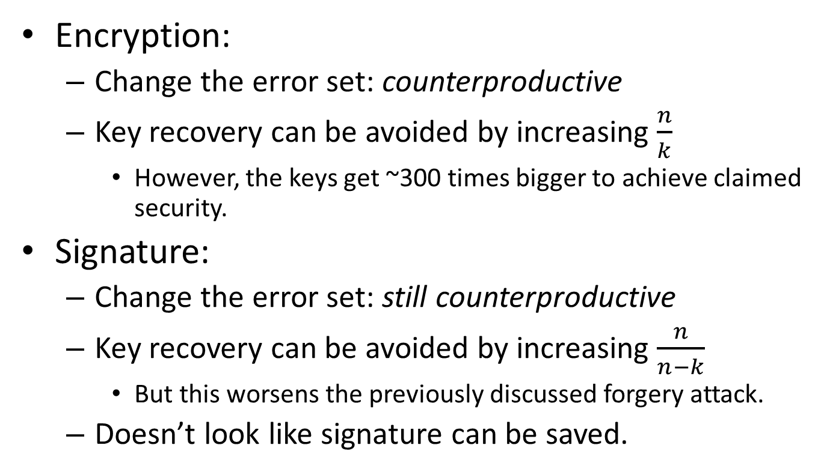
Can the scheme be saved?
Encryption:
Change the error set: counterproductive
Key recovery can be avoided by increasing $\frac{n}{k}$
However, the keys get ~300 times bigger to achieve claimed security.
Signature:
Change the error set: still counterproductive
Key recovery can be avoided by increasing $\frac{n}{n−k}$
But this worsens the previously discussed forgery attack.
Doesn’t look like signature can be saved.

Slide 24
Conclusions
We demonstrated two highly efficient attacks
Near trivial signature forgery.
Practical key recovery for both signature and encryption.
It is possible the encryption scheme can be saved
Although at the cost of making an inefficient scheme several orders of magnitude worse.
Attack is only quasi-polynomially costlier than decryption.
The signature scheme does not appear fixable

Slide 25
Thank You!

